Slide 1



SALES ANALYSIS REPORT
20
22
presented by
Abhishek Kumar

Slide 2

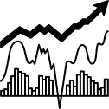
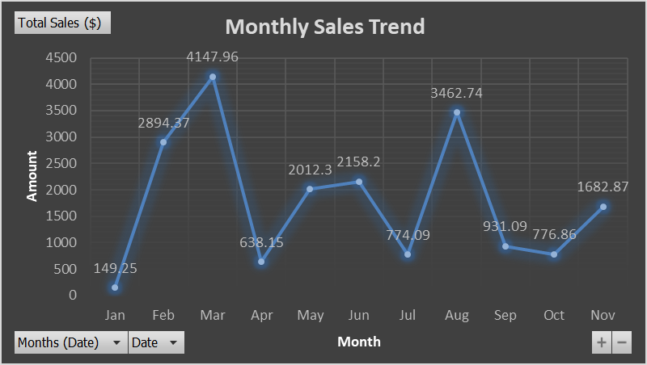
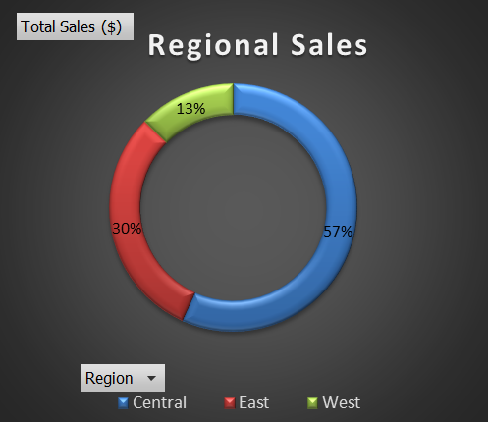
MARKET
TRENDS
20
22

Slide 3


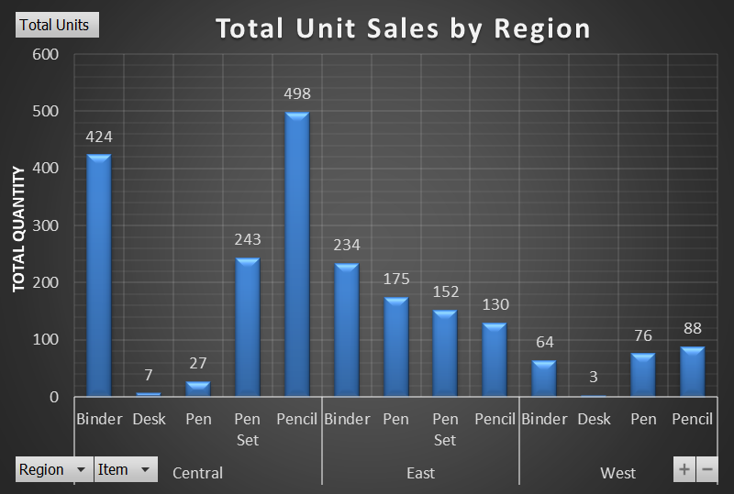
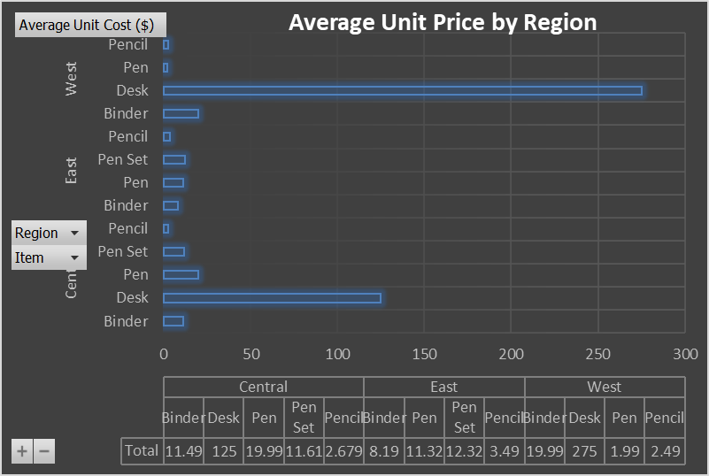
20
22
SALES
PERFORMANCE

Slide 4


SALES STRATEGIES, INITIATIVES
20
22
AND ACTION PLAN
The strategy focuses on boosting sales during low-performing months (Jan, Apr, Jul, Sep, Oct) and increasing market penetration in underperforming regions, especially the West. Targeted marketing, sales promotions, and strengthened customer relationships will be key, along with data-driven insights to sustain Central region performance.
To address regional variations, the strategy will optimize product offerings based on local preferences, with a focus on improving sales in the West by increasing Binder and Desk penetration. In the Central region, complementary products will be introduced to capitalize on strong sales of Binders and Pencils.
Pricing strategy will aim to standardize prices across regions, enhancing competitiveness, particularly in the West, where high-value items like Desks and Binders are priced higher. Aligning pricing with regional demand will help optimize revenue and customer satisfaction.
The action plan will be targeting low-performance months with promotions and focuses on regional growth. Boosting sales in the West with a dedicated team, upselling in the East, and maintaining Central region momentum. It includes optimizing products and pricing strategies, expanding product ranges in Central, promoting Pens in the East, and driving demand for Binders and Desks in the West. Region-specific campaigns, bundling, and dynamic pricing will enhance sales, while customer segmentation and feedback will refine offerings and ensure consistent stock levels across all regions.

Slide 5

THANK YOU!
Thank you for your attention to our sales report presentation. If you have any questions or would like to discuss the findings in more detail, please don't hesitate to reach out to our sales team. We appreciate your continued support and partnership.

